Slide 1



Slide 2
HI-TECH GARAGE
No lines. No delays. Just service, simplified.
Prepared and Presented by Salihah Sadiq 1369 Muneeb Shahid 1355 Manal 1335

Slide 3

PROBLEM 4
Lack of Immediate Roadside Assistance
Vehicle owners often face emergencies without access to fast, reliable roadside help, causing delays and safety concerns.
PROBLEM 3
PROBLEM 1
PROBLEM 2
Inefficient Workshop Booking Process
Traditional garage systems lack digital scheduling, leading to long waiting times and service mismanagement.

Slide 4

Lack of Immediate Roadside Assistance
Vehicle owners often face emergencies without access to fast, reliable roadside help, causing delays and safety concerns.
PROBLEM 4
Inefficient Workshop Booking Process
Traditional garage systems lack digital scheduling, leading to long waiting times and service mismanagement.
PROBLEM 3
PROBLEM 1
PROBLEM 2
Limited Access to Verified Workshops
Users struggle to find trusted, professional workshops nearby with transparent pricing and service options.

Slide 5

Inefficient Workshop Booking Process
Traditional garage systems lack digital scheduling, leading to long waiting times and service mismanagement.
PROBLEM 4
Limited Access to Verified Workshops
Users struggle to find trusted, professional workshops nearby with transparent pricing and service options.
PROBLEM 3
PROBLEM 1
PROBLEM 2
Absence of Digital Interaction & Support
Most workshops lack online platforms or AI-based assistance, making it hard for users to get quick service guidance or help

Slide 6

Limited Access to Verified Workshops
Users struggle to find trusted, professional workshops nearby with transparent pricing and service options.
PROBLEM 4
Absence of Digital Interaction & Support
Most workshops lack online platforms or AI-based assistance, making it hard for users to get quick service guidance or help
PROBLEM 3
PROBLEM 1
PROBLEM 2

Slide 7

5
PROPOSED SOLUTIONS
4
3
2
1

Slide 8
5
PROPOSED SOLUTIONS
Comprehensive Web Application
“A centralized and user-friendly platform designed to streamline vehicle service bookings, roadside assistance, and workshop interactions in one integrated system."
4
3
2
1

Slide 9
5
PROPOSED SOLUTIONS
4
Comprehensive Web Application
“A centralized and user-friendly platform designed to streamline vehicle service bookings, roadside assistance, and workshop interactions in one integrated system."
3
Immediate RoadSide Assistance
"Quick help at your location when your vehicle breaks down unexpectedly."
2
1

Slide 10
5
PROPOSED SOLUTIONS
4
Comprehensive Web Application
“A centralized and user-friendly platform designed to streamline vehicle service bookings, roadside assistance, and workshop interactions in one integrated system."
At Home and Workshop Booking
"Flexible service booking at your doorstep or your chosen workshop, hassle-free."
Immediate RoadSide Assistance
"Quick help at your location when your vehicle breaks down unexpectedly."
3
2
1

Slide 11
5
PROPOSED SOLUTIONS
4
Comprehensive Web Application
“A centralized and user-friendly platform designed to streamline vehicle service bookings, roadside assistance, and workshop interactions in one integrated system."
At Home and Workshop Booking
"Flexible service booking at your doorstep or your chosen workshop, hassle-free."
Immediate RoadSide Assistance
"Quick help at your location when your vehicle breaks down unexpectedly."
3
AI Powered ChatBot
"Instant support and guidance through an intelligent AI-powered chatbot."
2
1

Slide 12
5
PROPOSED SOLUTIONS
4
Comprehensive Web Application
“A centralized and user-friendly platform designed to streamline vehicle service bookings, roadside assistance, and workshop interactions in one integrated system."
At Home and Workshop Booking
"Flexible service booking at your doorstep or your chosen workshop, hassle-free."
Immediate RoadSide Assistance
"Quick help at your location when your vehicle breaks down unexpectedly."
3
AI Powered ChatBot
"Instant support and guidance through an intelligent AI-powered chatbot."
Timely Support and Efficient Management
"Ensuring quick assistance and streamlined service coordination for users and workshops."
2
1

Slide 13
OBJECTIVES
1
2
3
To book services at home or workshops.
To request emergency help anytime.
To get real-time AI support.

Slide 14
OBJECTIVES
1
2
3
To book services at home or workshops.
To request emergency help anytime.
To get real-time AI support.

Slide 15
OBJECTIVES
2
1
3
To request emergency help anytime.
To book services at home or workshops.
To get real-time AI support.

Slide 16
OBJECTIVES
3
1
2
To get real-time AI support.
To book services at home or workshops.
To request emergency help anytime.

Slide 17

TARGET MARKET
1
Daily Vehicle Users
2
Busy Professionals

Slide 18
TARGET MARKET
2
Busy Professionals
1
3
Daily Vehicle Users
Tourists & Travelers

Slide 19
TARGET MARKET
3
Tourists and Travelers
2
4
Local Vehicle Owners
Busy Professionals

Slide 20
TARGET MARKET
4
Local Vehicle Owners
3
5
Verified Vehicle Workshops
Tourists and Travelers

Slide 21
TARGET MARKET
5
Verified Vehicle Workshops
4
6
Local Vehicle Owners
Female Drivers

Slide 22

TARGET MARKET
6
Female Drivers
5
Verified Vehicle Workshops
FOR FRONT-END
HTML
Tailwind CSS
React.Js
FOR BACK-END
Firebase

Slide 23

PROJECT SCOPE
TOOLS AND TECHNOLOGIES
FOR FRONT-END
HTML
Tailwind CSS
React.Js
6
FOR BACK-END
Firebase
JavaScript
Female Drivers

Slide 24

METHODOLOGY – Agile Scrum
Rapid delivery: Functional modules delivered in short sprints
Adaptable: Easily adjusts to evolving requirements
Collaborative: Daily standups and sprint reviews boosts teamwork.
Quality Focused: Continuous Testing ensures high performance.

Slide 25

FUNCTIONAL REQUIREMENTS
Manage workshop profiles & services
Monitor service status & staff availability
Track tasks & appointments
In-app customer communication
Search workshops & their service
Book appointments with preferences
View User profile
View booking history & invoices

Slide 26
NON-FUNCTIONAL REQUIREMENTS
Support maximum user’s requests
Scalable for new workshops
Intuitive UI for all user roles
Maximum uptime with minimal downtime
Multi-device accessibility

Slide 27
USE CASE DIAGRAM

Slide 28
ACTIVITY DIAGRAM - Emergency

Slide 29
ACTIVITY DIAGRAM – On-Site Booking

Slide 30
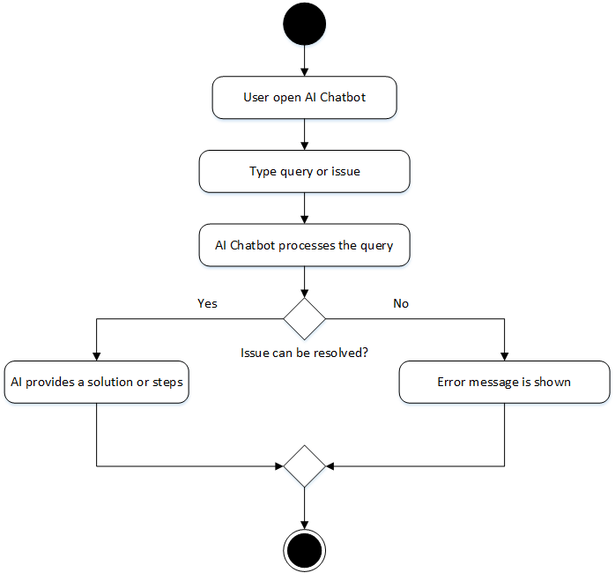
ACTIVITY DIAGRAM – AI Chatbot

Slide 31
DATA FLOW DIAGRAM

Slide 32
CLASS DIAGRAM

Slide 33
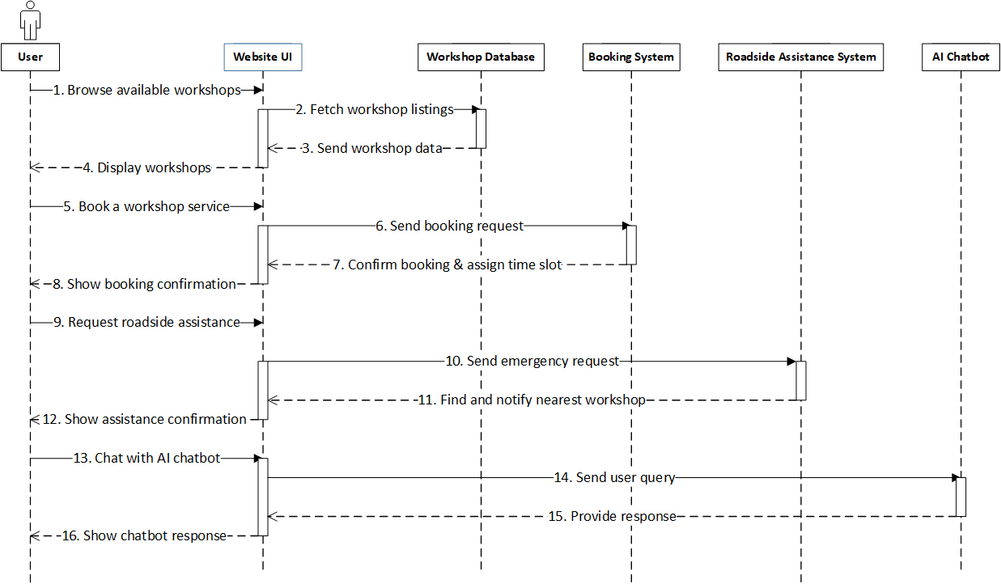
SEQUENCE DIAGRAM - User

Slide 34
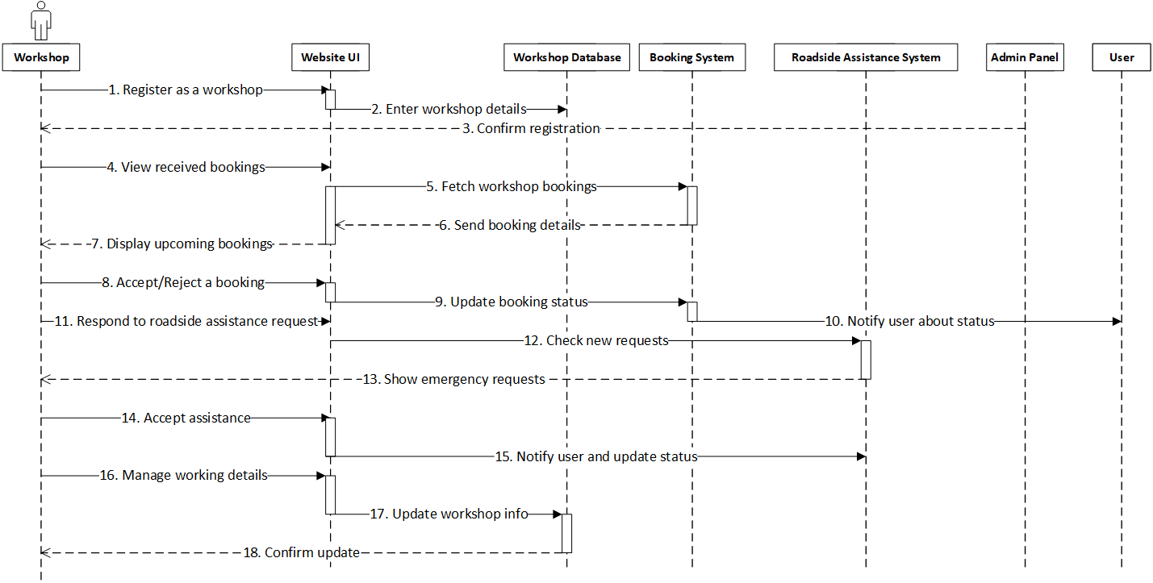
SEQUENCE DIAGRAM - Workshop

Slide 35
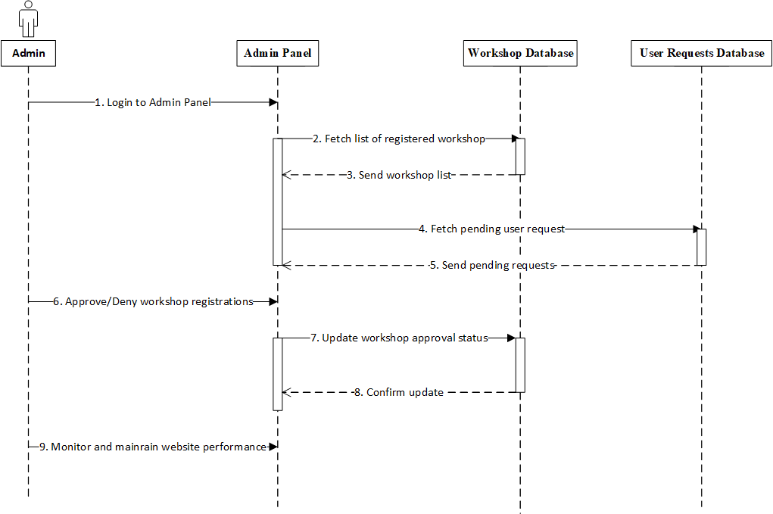
SEQUENCE DIAGRAM - Admin

Slide 36
TREE STRUCTURE

Slide 37
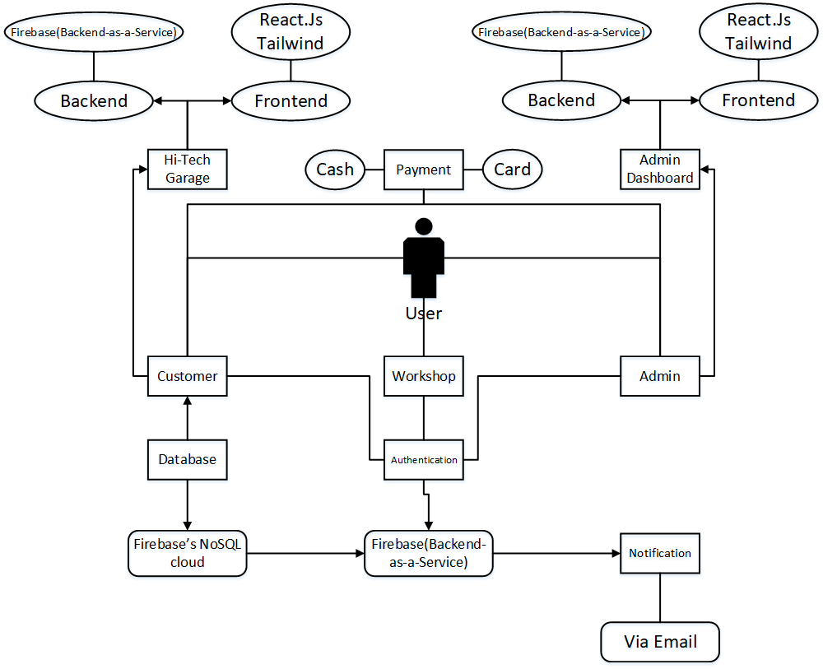
ARCHITECTURE DIAGRAM

Slide 38

THANK YOU FOR
YOUR ATTENTION!

